Slide 1
COMPUTER ARCHITECTURE BTCS-2301
Course Name: B.Tech (CSE) Semester: 3rd
Prepared by: Sahilpreet Singh
education for life www.rimt.ac.in
Department of Computer Science & Engineering

Slide 2
TOPIC:- BUS TYPES
education for life www.rimt.ac.in

Slide 3
Bus Types Dedicated vs. Time Multiplexed
Dedicated
Separate data & address lines
Time multiplexed
Shared lines
Address valid or data valid control line
Advantage - fewer lines
Disadvantages
More complex control
Degradation of performance
education for life www.rimt.ac.in

Slide 4
Bus Types Physical Dedication
Physically separating buses and controlling them with a "channel changer“
Advantages – faster
Disadvantages – physically larger
education for life www.rimt.ac.in

Slide 5
Bus Arbitration
Listening to the bus is not usually a problem
Talking on the bus is a problem – need arbitration to allow more than one module to control the bus at one time
Arbitration may be centralised or distributed
education for life www.rimt.ac.in

Slide 6
Centralised vs. Distributed Arbitration
Centralised Arbitration
Single hardware device controlling bus access – Bus Controller/Arbiter
May be part of CPU or separate
Distributed Arbitration
Each module may claim the bus
Access control logic is on all modules
Modules work together to control bus
education for life www.rimt.ac.in

Slide 7
Bus Timing
Co-ordination of events on bus
Synchronous – controlled by a clock
Asynchronous – timing is handled by well-defined specifications, i.e., a response is delivered within a specified time after a request
education for life www.rimt.ac.in

Slide 8
Synchronous Bus Timing
Events determined by clock signals
Control Bus includes clock line
A single 1-0 cycle is a bus cycle
All devices can read clock line
Usually sync on leading/rising edge
Usually a single cycle for an event
Analogy – Orchestra conductor with baton
Usually stricter in terms of its timing requirements
education for life www.rimt.ac.in

Slide 9
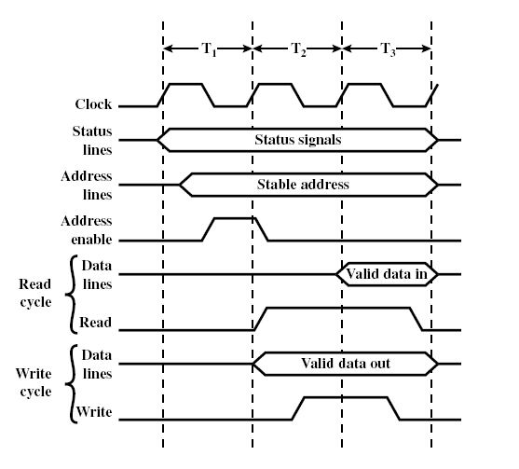
Synchronous Bus Timing
education for life www.rimt.ac.in

Slide 10
Asynchronous Timing
Devices must have certain tolerances to provide responses to signal stimuli
More flexible allowing slower devices to communicate on same bus with faster devices.
Performance of faster devices, however, is limited to speed of bus
education for life www.rimt.ac.in

Slide 11
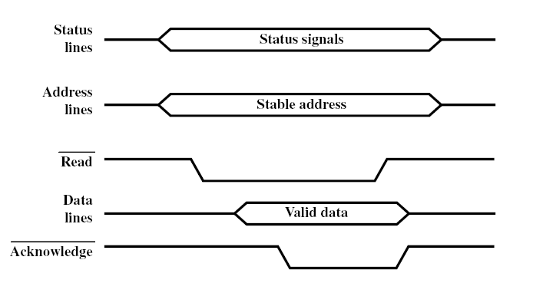
Asynchronous Timing – Read
education for life www.rimt.ac.in

Slide 12
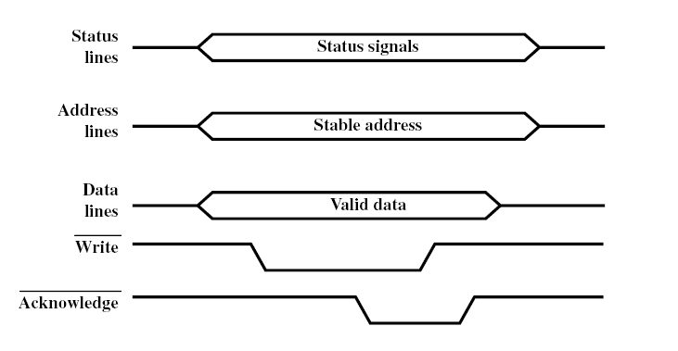
Asynchronous Timing – Write
education for life www.rimt.ac.in

Slide 13
Bus Width
Wider the bus the better the data transfer rate or the wider the addressable memory space
Serial “width” is determined by length/duration of frame
education for life www.rimt.ac.in

