Slide 1
EXPERT SYSTEM BTCS-3613
Course Name: B.Tech (CSE) Semester: 6th
Prepared by: Sahilpreet Singh
education for life www.rimt.ac.in
Department of Computer Science & Engineering

Slide 2
Topic:-Techniques of knowledge representation
education for life www.rimt.ac.in

Slide 3
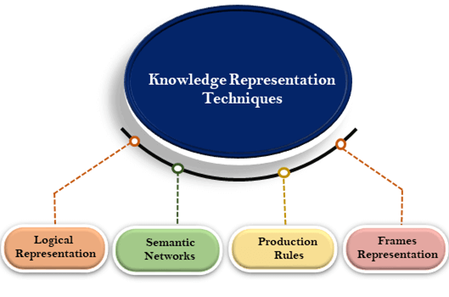
education for life www.rimt.ac.in

Slide 4
Logical Representation
Logical representation means drawing a conclusion based on various conditions.
This representation lays down some important communication rules.
It acts as a communication rule and it can be used when representing facts to a machine
Logical Representation
1 | 0
YES | NOT
OR | NOR
XOR | XNOR
AND | NAND
education for life www.rimt.ac.in

Slide 5
Semantic Network Representation
In Semantic networks, we can represent our knowledge in the form of graphical networks.
This network consists of nodes representing objects and arcs which describe the relationship between those objects.
This representation consist of mainly two types of relations:
IS-A relation (Inheritance)
Kind-of-relation
education for life www.rimt.ac.in

Slide 6
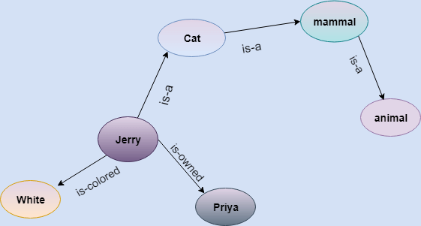
STATEMENT
Jerry is a cat.
Jerry is a mammal
Jerry is owned by Priya.
Jerry is brown colored.
All Mammals are animal
Drawbacks in Semantic representation:
Semantic networks take more computational time at runtime as we need to traverse the complete network tree to answer some questions.
These networks are not intelligent and depend on the creator of the system.
Advantages
Semantic networks are a natural representation of knowledge.
Semantic networks convey meaning in a transparent manner.
These networks are simple and easily understandable.
education for life www.rimt.ac.in

Slide 7
Frame Representation
A frame is a record like structure which consists of a collection of attributes and its values to describe an entity in the world.
Frames are the AI data structure which divides knowledge into substructures by representing stereotypes situations.
It consists of a collection of slots and slot values. These slots may be of any type and sizes.
Slots have names and values which are called facets.
Slots | Filters
Title | Artificial Intelligence
Genre | Computer Science
Author | Peter Norvig
Edition | Third Edition
Year | 1996
Page | 1152
education for life www.rimt.ac.in

Slide 8
Advantages
The frame knowledge representation makes the programming easier by grouping the related data.
The frame representation is comparably flexible and used by many applications in AI.
It is very easy to add slots for new attribute and relations.
It is easy to include default data and to search for missing values.
Frame representation is easy to understand and visualize.
Disadvantages of frame representation:
In frame system inference mechanism is not be easily processed.
Inference mechanism cannot be smoothly proceeded by frame representation.
Frame representation has a much generalized approach.
education for life www.rimt.ac.in

Slide 9
Production Rules
Production rules system consist of (condition, action) pairs which mean, "If condition then action".
It has mainly three parts:
The set of production rules
Working Memory
The recognize-act-cycle
education for life www.rimt.ac.in

Slide 10
In production rules agent checks for the condition and if the condition exists then production rule fires and corresponding action is carried out.
The working memory contains the description of the current state of problems-solving and rule can write knowledge to the working memory
The condition part of the rule determines which rule may be applied to a problem. And the action part carries out the associated problem-solving steps.
education for life www.rimt.ac.in

Slide 11
Example:
IF (at bus stop AND bus arrives) THEN action (get into the bus)
IF (on the bus AND paid AND empty seat) THEN action (sit down).
IF (on bus AND unpaid) THEN action (pay charges).
IF (bus arrives at destination) THEN action (get down from the bus).
education for life www.rimt.ac.in

