Slide 1
Numerical and Statistical Methods (BTEE-3604)
Course Name: B.Tech. (EE) Semester: 6th
Prepared by: Sachin Syan
education for life www.rimt.ac.in
Department of Electrical Engineering

Slide 2
Topic Discussed
Definition of a Random Variable
Discrete Random Variables
Expectations, Variances
Binomial Distribution
Poisson Distribution
Continuous Random Variables
Normal Distribution
education for life www.rimt.ac.in
Department of Electrical Engineering

Slide 3
Definition of a Random Variable`
Random variable : It is a real valued function defined on a sample space S. In a particular experiment, a random variable X would be some function that assigns a real number X(s) for each possible outcome
Discrete random variable : It can take a countable number of values.
Continuous random variable : It can take any value along a given interval of a number line.
education for life www.rimt.ac.in
Department of Electrical Engineering

Slide 4
Probability Distributions, Mean and Variance
for Discrete Random Variables
The probability distribution of a discrete random variable is defined as a function that specifies the probability associated with each possible outcome the random variable can assume.
(a) p(x) ≥ 0 for all values of x
Σp(x) = 1
The mean, or expected value, of a discrete random variable is
The variance of a discrete random variable x is
education for life www.rimt.ac.in
Department of Electrical Engineering

Slide 5
Binomial Distribution
A Binomial Random Variable
n identical trials
Two outcomes: Success or Failure
P(S) = p; P(F) = q = 1 – p
Trials are independent
x is the number of S’s in n trials
education for life www.rimt.ac.in
Department of Electrical Engineering

Slide 6
Binomial Distribution
Example
Results of 3 flips | Probability | Combined | Summary
HHH | (p)(p)(p) | p³ | (1)p³q⁰
HHT | (p)(p)(q) | p²q
HTH | (p)(q)(p) | p²q | (3)p²q¹
THH | (q)(p)(p) | p²q
HTT | (p)(q)(q) | pq²
THT | (q)(p)(q) | pq² | (3)p¹q²
TTH | (q)(q)(p) | pq²
TTT | (q)(q)(q) | q³ | (1)p⁰q³
education for life www.rimt.ac.in
Department of Electrical Engineering

Slide 7
Binomial Distribution Probability Distribution
The probability of getting the required number of successes
The probability of getting the required number of failures
The number of ways of getting the desired results
education for life www.rimt.ac.in
Department of Electrical Engineering

Slide 8
Mean and Variance of Binomial Distribution
education for life www.rimt.ac.in
Department of Electrical Engineering

Slide 9
Binomial Distribution Probability Distribution
Example: Say 40% of the class is female. What is the probability that 6 of the first 10 students walking in will be female?
Solution
education for life www.rimt.ac.in
Department of Electrical Engineering

Slide 10
Poisson Distribution
Probability distribution is
(i)  = mean number of occurrences
(ii) Mean µ = , variance: ² = 
education for life www.rimt.ac.in
Department of Electrical Engineering

Slide 11
Poisson Distribution
Example: Say in a given stream there are an average of 3 striped trout per 100 yards. What is the probability of seeing 5 striped trout in the next 100 yards, assuming a Poisson distribution?
Solution
education for life www.rimt.ac.in
Department of Electrical Engineering

Slide 12
Continuous Probability Distributions
A continuous distribution can be characterized by its probability density function.
For example: for an interval (a, b],
The function f (x) is called the probability density function of X. Every p.d.f. f (x) must satisfy
education for life www.rimt.ac.in
Department of Electrical Engineering

Slide 13
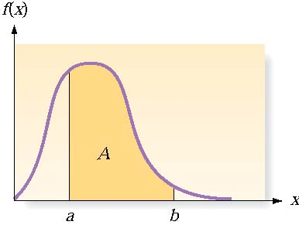
Continuous Probability Distributions
There are an infinite number of possible outcomes
P(x) = 0
Instead, find P(a < x ≤ b)
Table
Integral calculus
If a random variable X has a continuous distribution for which the p.d.f. is f(x), then the expectation E(X) and variance Var (X) are defined as follows:
education for life www.rimt.ac.in
Department of Electrical Engineering

Slide 14
Normal Distribution
The probability density function f(x):
µ = the mean of x,  = the standard deviation of x
education for life www.rimt.ac.in
Department of Electrical Engineering
Notes:
Closely approximates many situations
Perfectly symmetrical around its mean

Slide 15
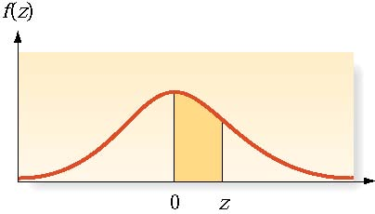
Normal Distribution
Example: Say a toy car goes an average of 3,000 yards between recharges, with a standard deviation of 50 yards (i.e., µ = 3,000 and  = 50) . What is the probability that the car will go more than 3,100 yards without recharging?
Solution
education for life www.rimt.ac.in
Department of Electrical Engineering
Notes:
Closely approximates many situations
Perfectly symmetrical around its mean

Slide 16
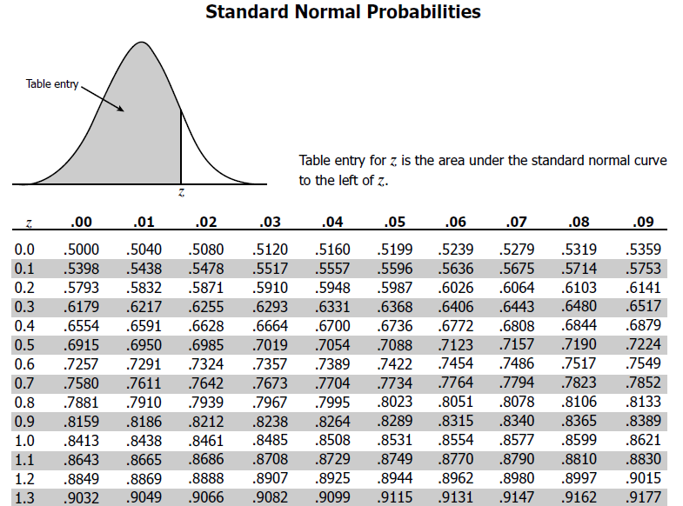
education for life www.rimt.ac.in
Department of Electrical Engineering
Notes:
Closely approximates many situations
Perfectly symmetrical around its mean

Slide 17
Topics Discussed in Next Lecture
Population or Universe
Sampling
Parameter of sampling
Standard Errors
Test of Significance
Critical Region
Level of Significance
Errors in Sampling
Steps in testing of Statistical Hypothesis
education for life www.rimt.ac.in
Department of Electrical Engineering

