Slide 1
CLOUD COMPUTING BTCS-4712
Course Name: B. Tech (CSE) Semester: 7th
Prepared by: Sahilpreet Singh
education for life www.rimt.ac.in
Department of Computer Science & Engineering

Slide 2
Topic:-MULTI-TENANCY
education for life www.rimt.ac.in

Slide 3
INTRODUCTION
Tenant-
A person who occupies land & property rente from a lanlor.
A consumer who consumes services (SaaS, PaaS & IaaS) offere bu clou service proviers.
Multi-Tenancy
Have multiple tenant/Occupants.
S/W that is share by several consumers.
Each consumer is unaware of others.
education for life www.rimt.ac.in

Slide 4
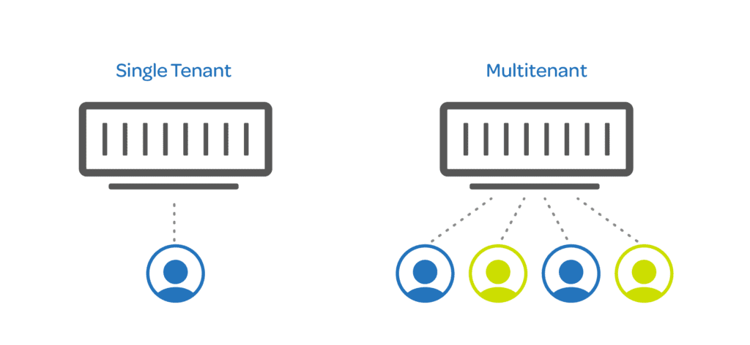
Multitenancy is when several different cloud customers are accessing the same computing resources.
As they are sharing the same computing resources but the data of each Cloud customer is kept totally separate and secure.
education for life www.rimt.ac.in

Slide 5
Importance of Multi-tenancy
It helps us to gain the maximum benefit from the public cloud environment
Multi-tenancy offers quality and consistent cloud access to everyone at an affordable price
When the cloud host introduces new functionalities, features, and innovations, a larger audience benefits from those improvements.
education for life www.rimt.ac.in

Slide 6
TYPES OF TENANCY
Cloud-Managed Services Tenancy
This type of tenancy is often found in the public cloud environment and where shared services are offered.
Cloud service providers offer some level of control, organizations using these shared services don’t have full control over the environment.
education for life www.rimt.ac.in

Slide 7
Independent Resource Tenancy (IRM)
IRM is an independent tenancy where organizations are given their own virtualized environment that is isolated from other organizations.
This gives the tenant full control over their resources and allows them to make changes to the environment as they see fit.
This type of tenancy is most often found in the private cloud environment, where organizations are given their own virtualized environment that is isolated from other organizations on the same physical infrastructure.
education for life www.rimt.ac.in

Slide 8
Equal-Storage Independent Resource Tenancy (E-IRM)
E-IRM is a type of tenancy that gives each tenant an equal amount of storage.
This type of tenancy is most often utilized in a hybrid cloud environment where organizations are given an equal amount of storage from the public cloud and a private cloud.
education for life www.rimt.ac.in

Slide 9
Equivalent-Resource Independent Resource Tenancy (Equivalent IRM)
This type of tenancy gives each tenant an equal amount of resources, such as processing power, bandwidth, and memory.
This is best suited for organizations that have a number of different workloads or applications that they want to move to the cloud.
In this tenants can be given the resources they need to run their applications.
education for life www.rimt.ac.in

Slide 10
Advantages of Multi-tenancy
Use of Available resources is maximized by sharing resources.
Customer’s Cost of Physical Hardware System is reduces.
It reduce usage of physical devices and thus power consumption and cooling cost save.
Save Vendor’s cost as it become difficult for cloud vendor to provide separate Physical Services to each individual.
Provides isolation to user while maximizing resource utilization.
education for life www.rimt.ac.in

Slide 11
Dis-advantages of Multi-tenancy
As data is stored in third party services , this reduces security of our data and put it into vulnerable condition .
Unauthorized access will cause damage of data.
There are possible response time issues. Apps may be less flexible. Shared applications tend to be less flexible than apps provided in other tenant architectures.
education for life www.rimt.ac.in

