Slide 1
COMPUTER ARCHITECTURE BTCS-2301
Course Name: B.Tech (CSE) Semester: 3rd
Prepared by: Sahilpreet Singh
education for life www.rimt.ac.in
Department of Computer Science & Engineering

Slide 2
Topic:-Memory Hierarchy
education for life www.rimt.ac.in

Slide 3
INTRODUCTION
Memory hierarchy is the hierarchy of memory and storage devices found in a computer system.
It ranges from the slowest but high capacity auxiliary memory to the fastest but low capacity cache memory.
education for life www.rimt.ac.in

Slide 4
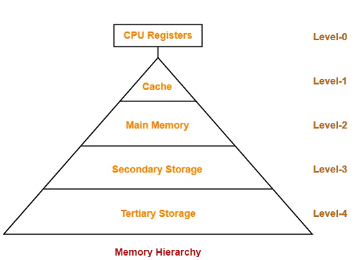
education for life www.rimt.ac.in

Slide 5
Level-0:
At level-0, registers are present which are contained inside the CPU.
Since they are present inside the CPU, they have least access time.
They are most expensive and therefore smallest in size (in KB).
Registers are implemented using Flip-Flops.
education for life www.rimt.ac.in

Slide 6
Level-1:
At level-1, Cache Memory is present.
It stores the segments of program that are frequently accessed by the processor.
It is expensive and therefore smaller in size (in MB).
Cache memory is implemented using static RAM.
education for life www.rimt.ac.in

Slide 7
Level-2:
At level-2, main memory is present.
It can communicate directly with the CPU and with auxiliary memory devices through an I/O processor.
It is less expensive than cache memory and therefore larger in size (in few GB).
Main memory is implemented using dynamic RAM
education for life www.rimt.ac.in

Slide 8
Level-3:
At level-3, secondary storage devices like Magnetic Disk are present.
They are used as back up storage.
They are cheaper than main memory and therefore much larger in size (in few TB).
education for life www.rimt.ac.in

Slide 9
Level-4:
At level-4, tertiary storage devices like magnetic tape are present.
They are used to store removable files.
They are cheapest and largest in size (1-20 TB)
education for life www.rimt.ac.in

Slide 10
Goals of Memory Hierarchy
To obtain the highest possible average access speed
To minimize the total cost of the entire memory system
education for life www.rimt.ac.in

