Slide 1
INDUSTRIAL ENGINEERING AND MANAGEMENT (BTME-4701)
Course Name: B.Tech-ME Semester: 7th
Prepared by: Dr. Talwinder Singh Bedi
education for life www.rimt.ac.in
Department of Mechanical Engineering

Slide 2
UNIT: III
education for life www.rimt.ac.in
Department of Mechanical Engineering

Slide 3
UNIT: III
education for life www.rimt.ac.in
Department of Mechanical Engineering

Slide 4
UNIT: III
education for life www.rimt.ac.in
Department of Mechanical Engineering

Slide 5
UNIT: III
education for life www.rimt.ac.in
Department of Mechanical Engineering

Slide 6
UNIT: III
education for life www.rimt.ac.in
Department of Mechanical Engineering

Slide 7
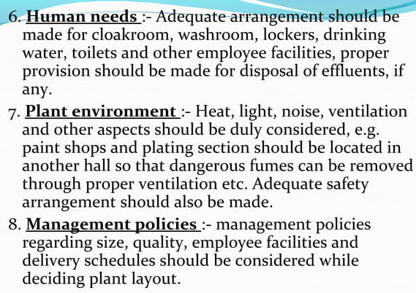
UNIT: III
education for life www.rimt.ac.in
Department of Mechanical Engineering

Slide 8
UNIT: III
education for life www.rimt.ac.in
Department of Mechanical Engineering

Slide 9
UNIT: III
education for life www.rimt.ac.in
Department of Mechanical Engineering

Slide 10
UNIT: III
education for life www.rimt.ac.in
Department of Mechanical Engineering

Slide 11
UNIT: III
education for life www.rimt.ac.in
Department of Mechanical Engineering

Slide 12
UNIT: III
education for life www.rimt.ac.in
Department of Mechanical Engineering

Slide 13
UNIT: III
education for life www.rimt.ac.in
Department of Mechanical Engineering

Slide 14
UNIT: III
education for life www.rimt.ac.in
Department of Mechanical Engineering

Slide 15
UNIT: III
education for life www.rimt.ac.in
Department of Mechanical Engineering

Slide 16
UNIT: III
education for life www.rimt.ac.in
Department of Mechanical Engineering

Slide 17
UNIT: III
education for life www.rimt.ac.in
Department of Mechanical Engineering

