Slide 1
Numerical and Statistical Methods (BTEE-3604)
Course Name: B.Tech. (EE) Semester: 6th
Prepared by: Sachin Syan
education for life www.rimt.ac.in
Department of Electrical Engineering

Slide 2
Topic Discussed
STUDENT’S t-DISTRIBUTION
SNEDECOR’S VARIANCE RATIO TEST OR F-TEST
CHI-SQUARE (χ²) TEST
education for life www.rimt.ac.in
Department of Electrical Engineering

Slide 3
STUDENT’S t-DISTRIBUTION
This t-distribution is used when sample size is ≤ 30 and the population standard deviation is unknown.
t-statistic is defined as t(n – 1 d. f) d.f–degrees of freedom
Where
education for life www.rimt.ac.in
Department of Electrical Engineering

Slide 4
STUDENT’S t-DISTRIBUTION
Applications of t-Distribution
Some of the applications of t-distribution are given below:
1. To test if the sample mean ( ) X differs significantly from the hypothetical value μ of the population mean. 2. To test the significance between two sample means. 3. To test the significance of observed partial and multiple correlation coefficients.
Critical Value of t The critical value or significant value of t at level of significance α degrees of freedom γ for two tailed test is given by
The significant value of t at level of significance α for a single tailed test can be determined from those of two-tailed test by referring to the values at 2α.
education for life www.rimt.ac.in
Department of Electrical Engineering

Slide 5
STUDENT’S t-DISTRIBUTION
TEST I: t-TEST OF SIGNIFICANCE OF THE MEAN OF A RANDOM SAMPLE
To test whether the mean of a sample drawn from a normal population deviates significantly from a stated value when variance of the population is unknown. H₀: There is no significant difference between the sample mean x and the population mean μ, i.e., we use the statistic
At a given level of significance α₁ and degrees of freedom (n – 1). We refer to t-table t_{α} (two-tailed or one-tailed). If calculated t value is such that | t | < t_{α} the null hypothesis is accepted. | t | > t_{α}, H₀ is rejected.
education for life www.rimt.ac.in
Department of Electrical Engineering

Slide 6
STUDENT’S t-DISTRIBUTION
Example 1. A random sample of size 16 has 53 as mean. The sum of squares of the derivation from mean is 135. Can this sample be regarded as taken from the population having 56 as mean? Obtain 95% and 99% confidence limits of the mean of the population.
Sol. H₀: There is no significant difference between the sample mean and hypothetical population mean. H₀: μ = 56; H1: μ ≠ 56 (Two-tailed test)
Given: X = 53, μ = 56, n = 16, Σ(X - X) - 2 = 135
education for life www.rimt.ac.in
Department of Electrical Engineering

Slide 7
STUDENT’S t-DISTRIBUTION
Conclusion. t_{0.05} = 1.753. Since | t | = 4 > t_{0.05} = 1.753, the calculated value of t is more than the table value. The hypothesis is rejected. Hence, the sample mean has not come from a population having 56 as mean.
95% confidence limits of the population mean
99% confidence limits of the population mean
education for life www.rimt.ac.in
Department of Electrical Engineering

Slide 8
STUDENT’S t-DISTRIBUTION
TEST II: t-TEST FOR DIFFERENCE OF MEANS OF TWO SMALL SAMPLES
This test is used to test whether the two samples x₁, x₂, ......, x_{n} , y₁, y₂, ......, y_{n} of sizes n₁, n₂ have been drawn from two normal populations with mean μ₁ and μ₂ respectively, under the assumption that the population variance are equal. (σ₁ = σ₂ = σ). H₀: The samples have been drawn from the normal population with means μ₁ and μ₂, i.e., H₀: μ1 ≠ μ2. Let X , Y be their means of the two samples. Under this H₀ the test of statistic t is given by
education for life www.rimt.ac.in
Department of Electrical Engineering

Slide 9
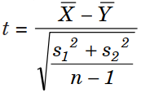
STUDENT’S t-DISTRIBUTION
NOTE: 1. If the two sample’s standard deviations s1, s2 are given, then we have
2. If n1 = n2 = n, can be used as a test statistic.
3. If the pairs of values are in some way associated (correlated) we can’t use the test statistic as given in Note 2. In this case, we find the differences of the associated pairs of values and apply for single mean i.e.,
with degrees of freedom n – 1
education for life www.rimt.ac.in
Department of Electrical Engineering

Slide 10
STUDENT’S t-DISTRIBUTION
Example Two samples of sodium vapor bulbs were tested for length of life and the following results were obtained:
Is the difference in the means significant to generalize that Type I is superior to Type II regarding length of life?
Sol. H₀: μ₁ = μ₂ i.e., two types of bulbs have same lifetime. H₁: μ₁ > μ₂ i.e., type I is superior to Type II.
education for life www.rimt.ac.in
Department of Electrical Engineering

Slide 11
STUDENT’S t-DISTRIBUTION
Conclusion. Since calculated | t | > t_{0.05}, H₀ is rejected, i.e. H₁ is accepted. ∴ Type I is definitely superior to Type II.
is an unbiased estimate of the population variance σ₂.
t follows t-distribution with n₁ + n₂ – 2 degrees of freedom.
education for life www.rimt.ac.in
Department of Electrical Engineering

Slide 12
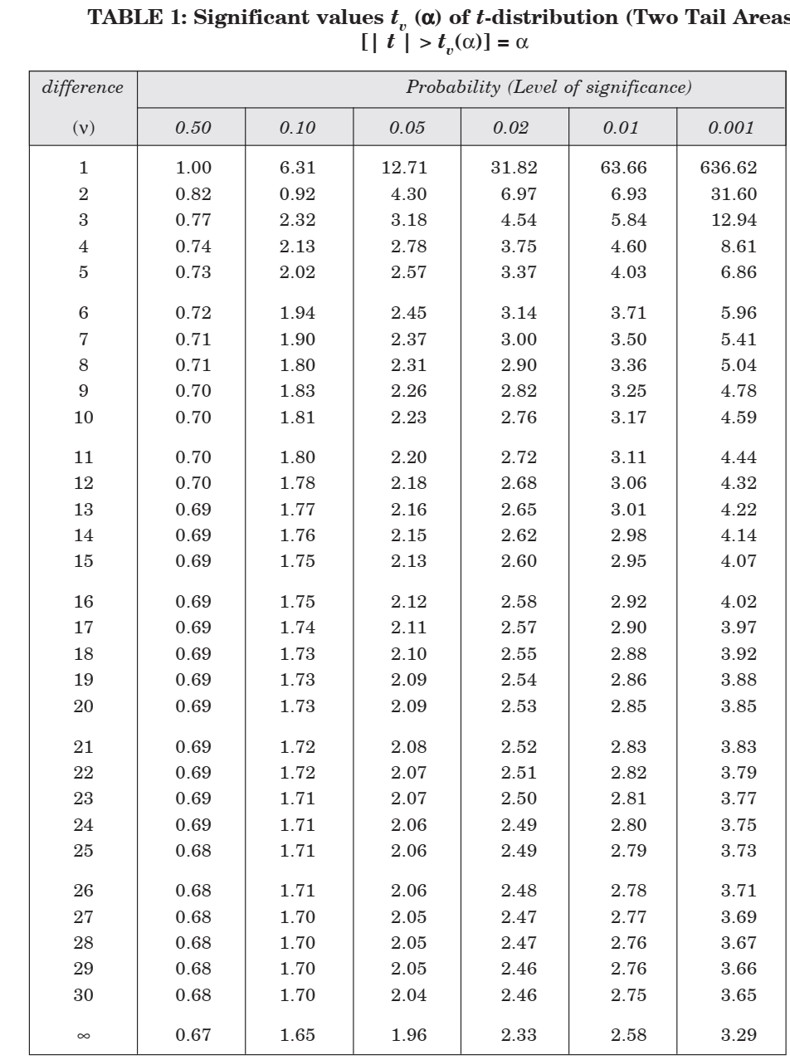
education for life www.rimt.ac.in
Department of Electrical Engineering

Slide 13
SNEDECOR’S VARIANCE RATIO TEST OR F-TEST
In testing the significance of the difference of two means of two samples, we assumed that the two samples came from the same population or populations with equal variance. The object of the F-test is to discover whether two independent estimates of population variance differ significantly or whether the two samples may be regarded as drawn from the normal populations having the same variance. Hence before applying the t-test for the significance of the difference of two means, we have to test for the equality of population variance by using the F-test.
Let n₁ and n₂ be the sizes of two samples with variance s₁² and s₂². The estimate of the population variance based on these samples is
The degrees of freedom of these estimates are ν₁ = n₁ – 1, ν₂ = n₂ – 1.
education for life www.rimt.ac.in
Department of Electrical Engineering

Slide 14
SNEDECOR’S VARIANCE RATIO TEST OR F-TEST
To test whether these estimates, s₁² and s₂², are significantly different or if the samples may be regarded as drawn from the same population or from two populations with same variance σ², we set-up the null hypothesis H₀: σ₁² = σ₂² = σ², i.e., the independent estimates of the common population do not differ significantly. To carry out the test of significance of the difference of the variances we calculate the test statistic population variance based on these samples is
the Numerator is greater than the Denominator, i.e., s₁² > s₂².
Conclusion. If the calculated value of F exceeds F_{0.05} for (n₁ – 1), (n₂ – 1) degrees of freedom given in the table, we conclude that the ratio is significant at 5% level. We conclude that the sample could have come from two normal population with same variance.
education for life www.rimt.ac.in
Department of Electrical Engineering

Slide 15
SNEDECOR’S VARIANCE RATIO TEST OR F-TEST
The assumptions on which the F-test is based are:
1. The populations for each sample must be normally distributed. 2. The samples must be random and independent.
3. The ratio of σ₁² to σ₂² should be equal to 1 or greater than 1. That is why we take the larger variance in the Numerator of the ratio.
Applications of F-Test
F-test is used to test whether two independent samples have been drawn from the normal populations with the same variance σ².
F-test is used to test whether the two independent estimates of the population variance are homogeneous or not.
education for life www.rimt.ac.in
Department of Electrical Engineering

Slide 16
SNEDECOR’S VARIANCE RATIO TEST OR F-TEST
Example 1. Two random samples drawn from 2 normal populations are as follows:
Test whether the samples are drawn from the same normal population.
Sol. To test if two independent samples have been drawn from the same population we have to test (i) equality of the means by applying the t-test and (ii) equality of population variance by applying F-test. Since the t-test assumes that the sample variances are equal, we shall first apply the F-test. F-test. 1. Null hypothesis
H₀: σ₁² = σ₂² i.e., the population variance do not differ significantly. Alternative hypothesis. H₁: σ₁² ≠ σ₂²
education for life www.rimt.ac.in
Department of Electrical Engineering

Slide 17
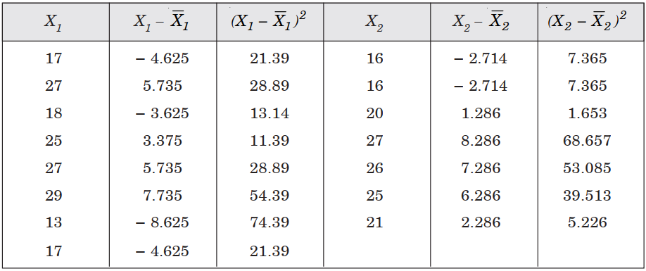
SNEDECOR’S VARIANCE RATIO TEST OR F-TEST
Computations for s₁² and s₂²
education for life www.rimt.ac.in
Department of Electrical Engineering

Slide 18
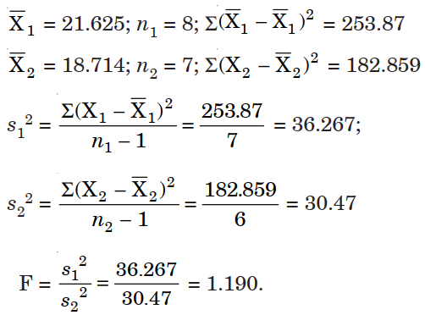
SNEDECOR’S VARIANCE RATIO TEST OR F-TEST
Conclusion. The table value of F for ν1 = 7 and ν2 = 6 degrees of freedom at 5% level is 4.21. The calculated value of F is less than the tabulated value of F.
∴ H0 is accepted. Hence we conclude that the variability in two populations is same.
education for life www.rimt.ac.in
Department of Electrical Engineering

Slide 19
SNEDECOR’S VARIANCE RATIO TEST OR F-TEST
t-test:
Null hypothesis. H₀: μ₁ = μ₂ i.e., the population means are equal. Alternative hypothesis. H₁: μ₁ ≠ μ₂ Test of statistic
Conclusion. The tabulated value of t at 5% level of significance for 13 difference is 2.16. The calculated value of t is less than the tabulated value. H₀ is accepted, i.e., there is no significant difference between the population mean. i.e., μ₁ = μ₂.
∴ We conclude that the two samples have been drawn from the same normal population.
education for life www.rimt.ac.in
Department of Electrical Engineering

Slide 20
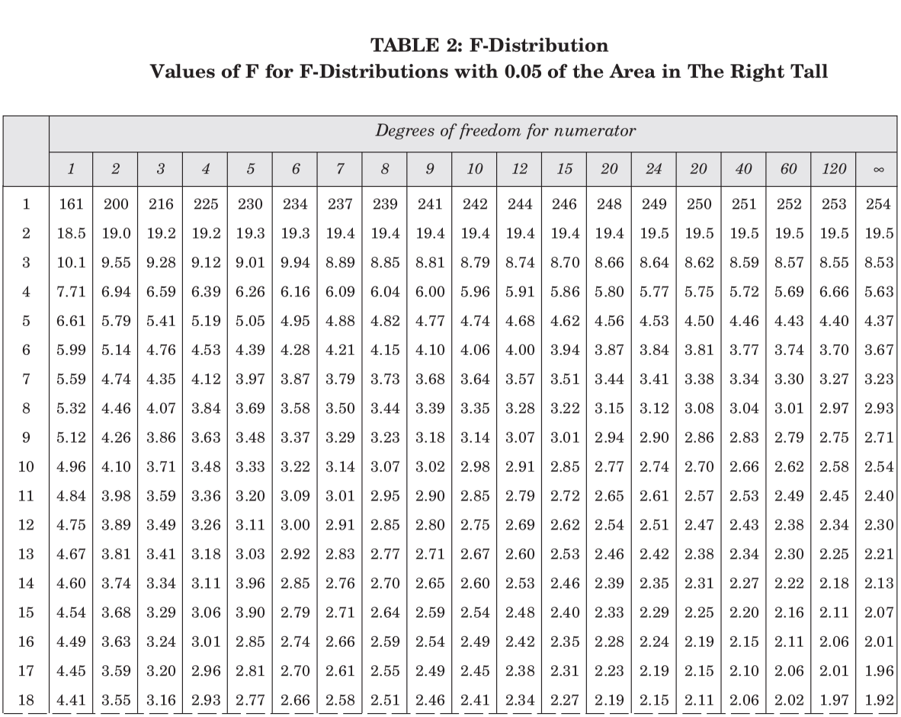
education for life www.rimt.ac.in
Department of Electrical Engineering

Slide 21
CHI-SQUARE (χ2) TEST
When a coin is tossed 200 times, the theoretical considerations lead us to expect 100 heads and 100 tails. But in practice, these results are rarely achieved. The quantity χ2 (a Greek letter, pronounced as chi-square) describes the magnitude of discrepancy between theory and observation. If χ = 0, the observed and expected frequencies completely coincide. The greater the discrepancy between the observed and expected frequencies, the greater is the value of χ2. Thus χ2 affords a measure of the correspondence between theory and observation.
If O_{i} (i = 1, 2, ......, n) is a set of observed (experimental) frequencies and E_{i} (i = 1, 2, ......, n) is the corresponding set of expected (theoretical or hypothetical) frequencies, then, χ2 is defined as
where ΣO_{i} = ΣE_{i} = N (total frequency) and degrees of freedom (difference)= (n – 1).
NOTE : (i) If χ² = 0, the observed and theoretical frequencies agree exactly. (ii) If χ² > 0 they do not agree exactly
education for life www.rimt.ac.in
Department of Electrical Engineering

Slide 22
CHI-SQUARE (χ2) TEST
While comparing the calculated value of χ2 with the table value, we have to determine the degrees of freedom.
Degrees of Freedom
degrees of freedom is the total number of observations less the number of independent constraints imposed on the observations.
Degrees of freedom (difference) are usually denoted by ν (the letter ‘nu’ of the Greek alphabet).
Thus, ν = n – k, where k is the number of independent constraints in a set of data of n observations.
(i) For a p × q contingency table (p columns and q rows), ν = (p – 1) (q – 1) (ii) In the case of a contingency table, the expected frequency of any class
education for life www.rimt.ac.in
Department of Electrical Engineering

Slide 23
CHI-SQUARE (χ2) TEST
Applications of χ² –Test
χ² test is one of the simplest and the most general test known. It is applicable to a very large number of problems in practice which can be summed up under the following heads:
(i) as a test of goodness of fit. (ii) as a test of independence of attributes. (iii) as a test of homogeneity of independent estimates of the population variance. (iv) as a test of the hypothetical value of the population variance s2. (v) as a list to the homogeneity of independent estimates of the population correlation coefficient.
education for life www.rimt.ac.in
Department of Electrical Engineering

Slide 24
CHI-SQUARE (χ2) TEST
Conditions for Applying χ² Test Following are the conditions which should be satisfied before χ2 test can be applied: (a) N, the total number of frequencies should be large. It is difficult to say what constitutes largeness, but as an arbitrary figure, we may say that N should be atleast 50, however small the number of cells. (b) No theoretical cell-frequency should be small. Here again, it is difficult to say what constitutes smallness, but 5 should be regarded as the very minimum and 10 is better. If small theoretical frequencies occur (i.e., < 10), the difficulty is overcome by grouping two or more classes together before calculating (O – E). It is important to remember that the number of degrees of freedom is determined with the number of classes after regrouping. (c) The constraints on the cell frequencies, if any, should be linear.
education for life www.rimt.ac.in
Department of Electrical Engineering

Slide 25
CHI-SQUARE (χ2) TEST
THE χ² DISTRIBUTION For large sample sizes, the sampling distribution of χ² can be closely approximated by a continuous curve known as the chi-square distribution. The probability function of χ² distribution is given by f (χ²) = c(χ²)^{(ν/2–1)}
where e = 2.71828, ν = number of degrees of freedom; c = a constant depending only on ν. The degrees of freedom are denoted by the symbol ν or by difference and are obtained by the rule ν = n – k, where k refers to the number of independent constraints.
In general, when we fit a binomial distribution the number of degrees of freedom is one less than the number of classes; when we fit a Poisson distribution the degrees of freedom are 2 less than the number of classes, because we use the total frequency and the arithmetic mean to get the parameter of the Poisson distribution. When we fit a normal curve the number of degrees of freedom are 3 less than the number of classes, because in this fitting we use the total frequency, mean and standard deviation.
If the data is given in a series of “n” numbers then degrees of freedom = n – 1. In the case of Binomial distribution difference = n – 1 In the case of Poisson distribution difference = n – 2 In the case of Normal distribution difference = n – 3
education for life www.rimt.ac.in
Department of Electrical Engineering

Slide 26
CHI-SQUARE (χ2) TEST
χ² TEST AS A TEST OF GOODNESS OF FIT χ² test enables us to ascertain how well the theoretical distributions such as Binomial, Poisson or Normal etc. fit empirical distributions, i.e., distributions obtained from sample data. If the calculated value of χ² is less than the table value at a specified level (generally 5%) of significance, the fit is considered to be good, i.e., the divergence between actual and expected frequencies is attributed to fluctuations of simple sampling. If the calculated value of χ² is greater than the table value, the fit is considered to be poor. Example: The following table gives the number of accidents that took place in an industry during various days of the week. Test if accidents are uniformly distributed over the week.
Sol. Null hypothesis H₀: The accidents are uniformly distributed over the week. Under this H₀, the expected frequencies of the accidents on each of these days
education for life www.rimt.ac.in
Department of Electrical Engineering

Slide 27
CHI-SQUARE (χ2) TEST
Conclusion. Table value of χ² at 5% level for (6 – 1 = 5 d.f.) is 11.09. Since the calculated value of χ² is less than the tabulated value, H₀ is accepted, the accidents are uniformly distributed over the week.
education for life www.rimt.ac.in
Department of Electrical Engineering

Slide 28
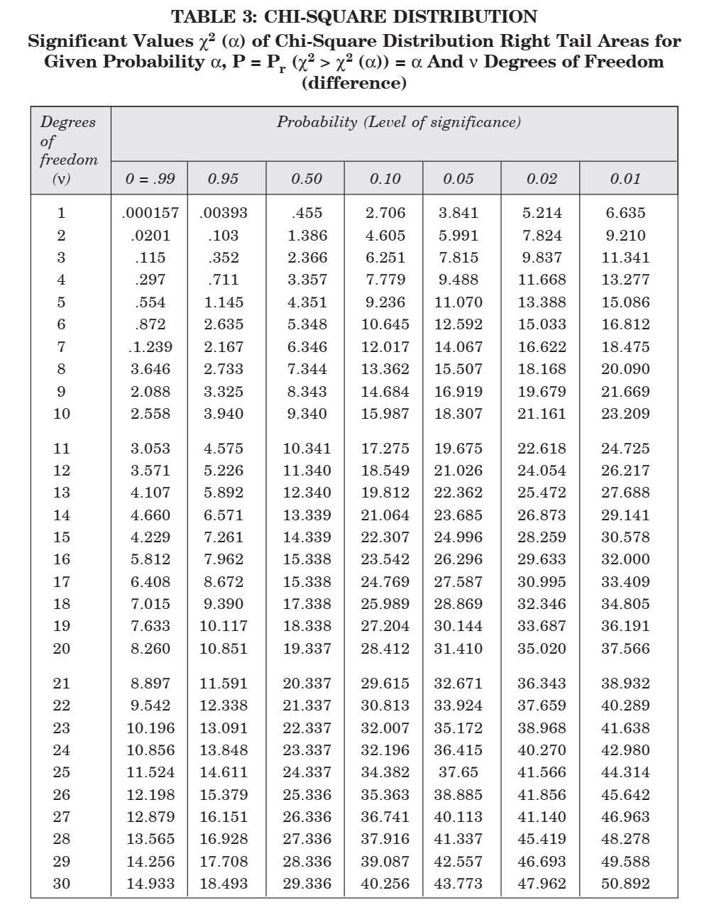
education for life www.rimt.ac.in
Department of Electrical Engineering

Slide 29
Topics Discussed in Next Lecture
Practice
education for life www.rimt.ac.in
Department of Electrical Engineering

