Slide 1
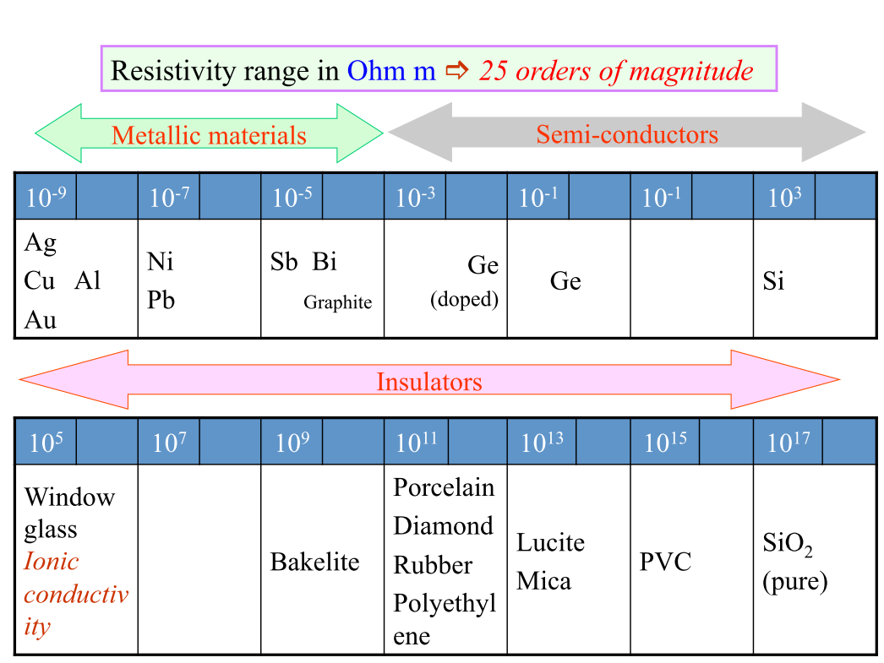
Materials Based on electrical resistivity

Slide 2
Dielectric materials
Class of insulators which polarizes on application of electric field
Difficult to excite electrons from valence to conduction band by thermal means or by applied electric field.
Very poor conductor of electricity.
Exhibits or may be made to exhibit an electric dipole structure;
Separation of positive and negative charged entities on a molecular/ atomic level.

Slide 3
Capacitance
When a voltage is applied across a capacitor, one plate becomes positively charged, the other negatively charged, with the corresponding electric field directed from the positive to the negative.
For a parallel plate with area A and distance t, in vacuum, C is given by
Relative permittivity of a free space

Slide 4
Dielectric permittivity/constant
For a given dielectric material with plates having area A and thickness t, C is given by
ε - Relative permittivity of a medium
The relative permittivity ε_{r} , often called the dielectric constant, is equal to the ratio
Dielectric constant – Charge storage capacity of the material

Slide 5
Polarization
Electric dipole, there is a separation between a + ve and a - ve electric charge.
Electric dipole moment p = q.d
+ ve
- ve
No electric field
In presence of an electric field
In presence of an electric field E, there will be a force (or torque) on the electric dipole to orient it with the applied field;
The process of dipole alignment is termed Polarization.

Slide 6
Polarization
Polarization is total dipole moment per unit volume
Polarization electric field within the dielectric that results from the mutual alignment of the many atomic or molecular dipoles with the externally applied field E.
For many dielectric materials, P is proportional to E through the relationship
P = ε₀ (ε_{r}-1)E

Slide 7
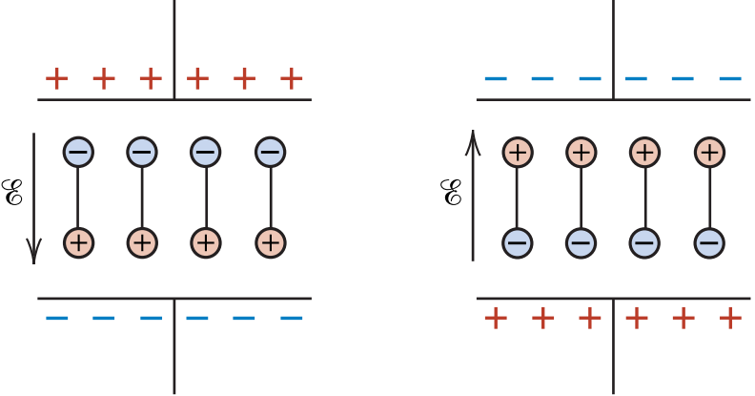
Polarization vs AC field
For many practical applications AC field is necessary
So, Dipoles has to reorient with the field
How much time does it take?

Slide 8
Polarization vs AC field
For each polarization type, some minimum reorientation time exists.
This time depends on the ease with which the particular dipoles are capable of realignment.
This time is called as relaxation time.
$P\left(t\right)=P_{0}\left[1−e^{−t/t_{r}}\right]$
P₀ = Maximum polarization attained on prolonged application of a static field.
P(t) = Polarization attained in time t.
t_{r} = relaxation time.
Relaxation frequency = Reciprocal of the relaxation time.

Slide 9
Dielectric loss/Power loss
Absorption of electrical energy by a dielectric material that is subjected to an alternating electric field.
Dielectric loss is the dissipation of energy through the movement of charges in an alternating electromagnetic field as polarization switches direction.
The dipoles could not follow the AC field and get relaxed or lose energy to become stable.

Slide 10
Types of Polarization
A dielectric material can have more than one polarizations present
Electronic polarization (P_{e})
Ionic polarization (P_{i})
Orientation/Dipolar polarization (P_{o})
Space charge polarization (P_{s})
The total polarization P of a substance is equal to sum of all types of polarizations
P = P_{e} + P_{i} + P_{o} + P_{s}

Slide 11
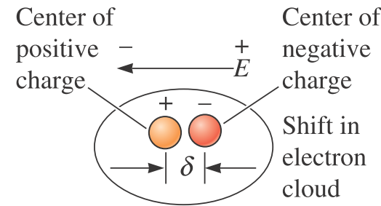
1. Electronic polarization
May be induced to one degree or another in all atoms.
Results from a displacement of the center of the negatively charged electron cloud relative to the positive nucleus of an atom by applied field.
Present in all dielectric materials and only when an electric field is applied.
Independent of temperature.
Relaxation frequency: ~ 10¹⁵ Hz.

Slide 12
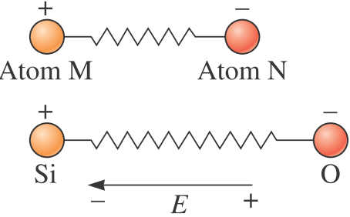
2. Ionic polarization
Occurs only in ionic materials.
Cations & anions are displaced in opposite direction due to field.
Magnitude of dipole moment for each ion pair.
p_{i} = qd_{i} ; d_{i} is relative displacement
Independent of temperature.
Relaxation frequency: ~ 10¹³ Hz.

Slide 13
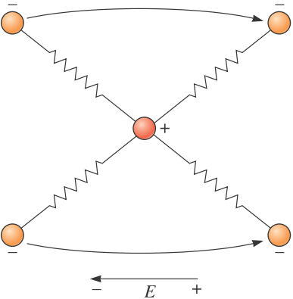
3. Orientation/Dipolar polarization
Found only in materials with permanent dipole moments.
Results from a rotation of the permanent moments into the direction of the applied field.
This alignment tendency is counteracted by the thermal vibrations of the atoms, such that polarization decreases with increasing temperature.
Relaxation frequency: ~ 10¹⁰ Hz.

Slide 14
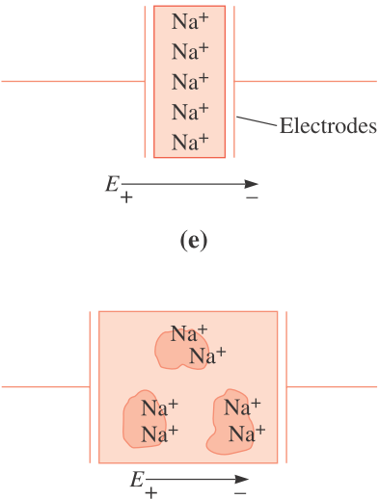
4. Space charge polarization
Occurs due to accumulation of charges at electrodes, grain boundaries or at interfaces in a multiphase materials.
Ions diffuse over appreciable distance in response to the applied electric field → redistribution of charges in the dielectric medium.
Increases with temperature.
Relaxation frequency: ~ 10² Hz.

Slide 15
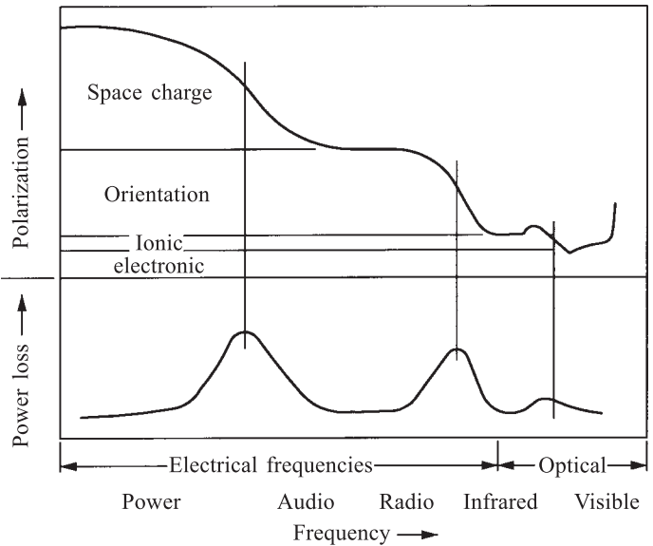
Dielectric polarization vs frequency
The polarization decreases with frequency

Slide 16
Dielectric field strength
Upper limit of the applied electric field
When very high electric fields are applied across dielectric materials, large numbers of electrons gets excited to energies within the conduction band.
As a result
The current increases through the dielectric dramatically
Localized melting,
burning,
or vaporization
This causes irreversible degradation and even failure of the material.
This phenomenon is known as dielectric breakdown.
The dielectric strength, sometimes called the breakdown strength, represents the magnitude of an electric field necessary to produce breakdown.

Slide 17
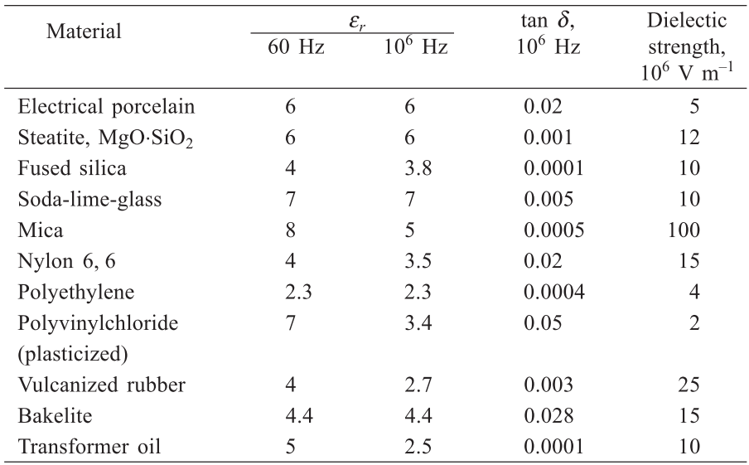
Selected dielectric materials

Slide 18
Summary
Dielectric materials are a class of insulator which gets polarizes on application of electric field.
Dielectric constant represents charge storage ability of the material.
Dipoles cannot reorient with applied AC field and lose some energy called as polarization loss.
Electronic polarization is fast while space charge polarization is slow.
Dielectric field strength is the ability to sustain electric field.

