Slide 1
Mathematics-III(BTME-3500)
Course Name: B.Tech. (ME) Semester: 5th
Prepared by: Sachin Syan
education for life www.rimt.ac.in
Department of Mechanical Engineering

Slide 2
Topic Discussed
Taylor’s and Laurent Series
Singularity
Types of Singularity
Residue
education for life www.rimt.ac.in
Department of Mechanical Engineering

Slide 3
Taylor’s Series
education for life www.rimt.ac.in
Department of Mechanical Engineering

Slide 4
Laurent’s Series
education for life www.rimt.ac.in
Department of Mechanical Engineering

Slide 5
Taylor’s and Laurent’s Series
education for life www.rimt.ac.in
Department of Mechanical Engineering

Slide 6
Taylor’s and Laurent’s Series
education for life www.rimt.ac.in
Department of Mechanical Engineering

Slide 7
Taylor’s and Laurent’s Series
education for life www.rimt.ac.in
Department of Mechanical Engineering

Slide 8
Singularity
Zero of analytic function
Isolated and Non-isolated
education for life www.rimt.ac.in
Department of Mechanical Engineering

Slide 9
Types of Singularity
education for life www.rimt.ac.in
Department of Mechanical Engineering

Slide 10
Types of Singularity
education for life www.rimt.ac.in
Department of Mechanical Engineering

Slide 11
Types of Singularity
education for life www.rimt.ac.in
Department of Mechanical Engineering

Slide 12
Types of Singularity
education for life www.rimt.ac.in
Department of Mechanical Engineering

Slide 13
Types of Singularity
education for life www.rimt.ac.in
Department of Mechanical Engineering

Slide 14
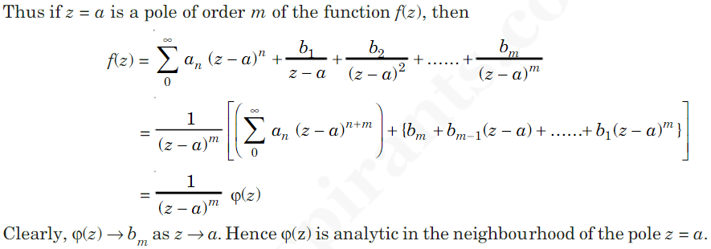
Types of Singularity
education for life www.rimt.ac.in
Department of Mechanical Engineering

Slide 15
Types of Singularity
education for life www.rimt.ac.in
Department of Mechanical Engineering

Slide 16
Types of Singularity
education for life www.rimt.ac.in
Department of Mechanical Engineering

Slide 17
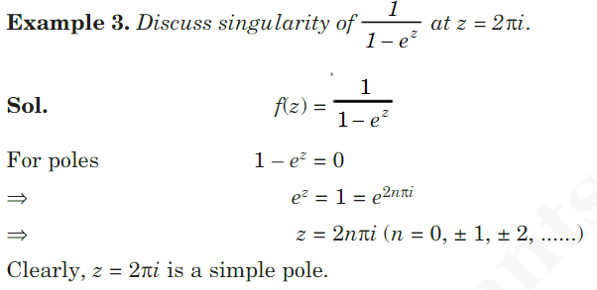
Types of Singularity
education for life www.rimt.ac.in
Department of Mechanical Engineering

Slide 18
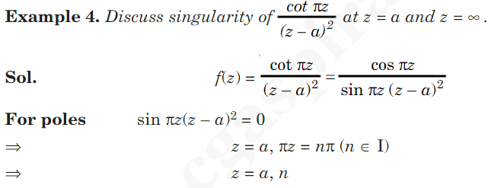
Types of Singularity
education for life www.rimt.ac.in
Department of Mechanical Engineering

Slide 19
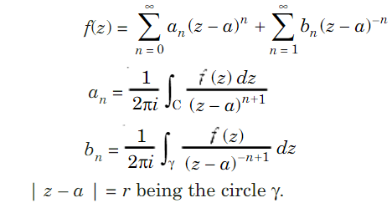
Residue At the Pole
education for life www.rimt.ac.in
Department of Mechanical Engineering

Slide 20
Residue At the Pole
education for life www.rimt.ac.in
Department of Mechanical Engineering

Slide 21
Residue at the Pole
education for life www.rimt.ac.in
Department of Mechanical Engineering

Slide 22
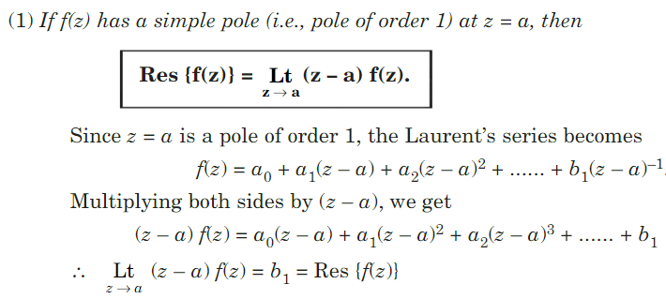
Methods of Finding Residues
education for life www.rimt.ac.in
Department of Mechanical Engineering

Slide 23
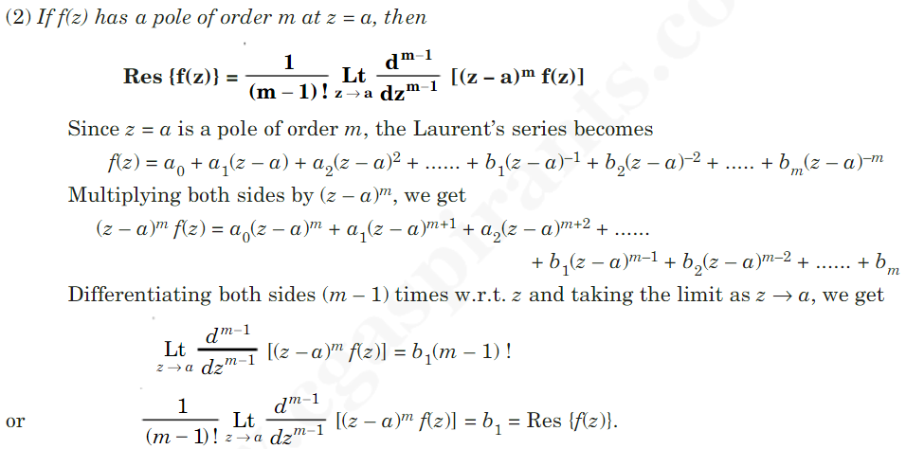
Methods of Finding Residues
education for life www.rimt.ac.in
Department of Mechanical Engineering

Slide 24
Methods of Finding Residues
education for life www.rimt.ac.in
Department of Mechanical Engineering

Slide 25
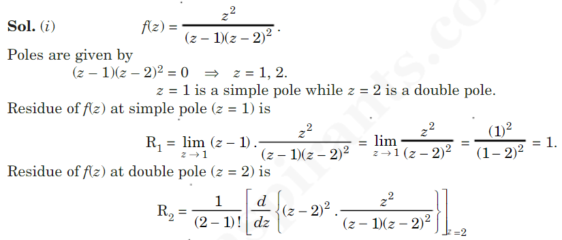
Methods of Finding Residues
education for life www.rimt.ac.in
Department of Mechanical Engineering

Slide 26
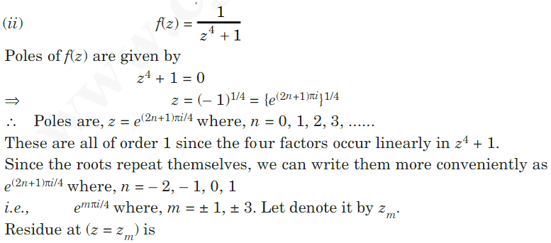
Methods of Finding Residues
education for life www.rimt.ac.in
Department of Mechanical Engineering

Slide 27
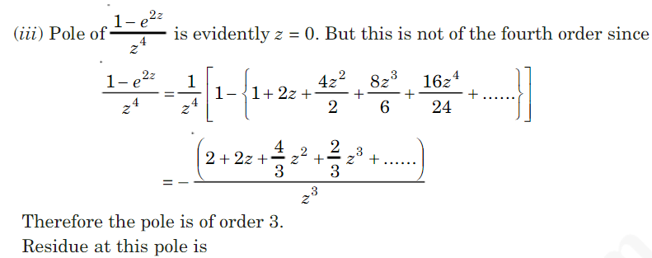
Methods of Finding Residues
education for life www.rimt.ac.in
Department of Mechanical Engineering

Slide 28
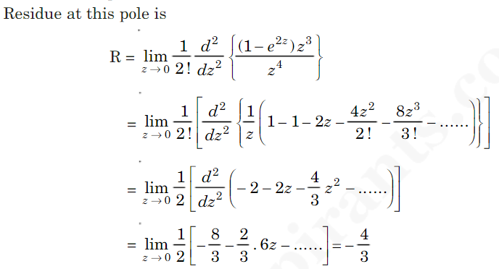
Methods of Finding Residues
education for life www.rimt.ac.in
Department of Mechanical Engineering

Slide 29
Topics Discussed in Next Lecture
Contour Integral
education for life www.rimt.ac.in
Department of Mechanical Engineering

