Slide 1
Mathematics-III(BTME-3500)
Course Name: B.Tech. (ME) Semester: 5th
Prepared by: Sachin Syan
education for life www.rimt.ac.in
Mechanical Engineering

Slide 2
Topic Discussed
Linear Integral in Complex Plane
Cauchy’s Theorem
Cauchy’s Integral formula
Cauchy’s Integral formula for Derivatives
education for life www.rimt.ac.in
Mechanical Engineering

Slide 3
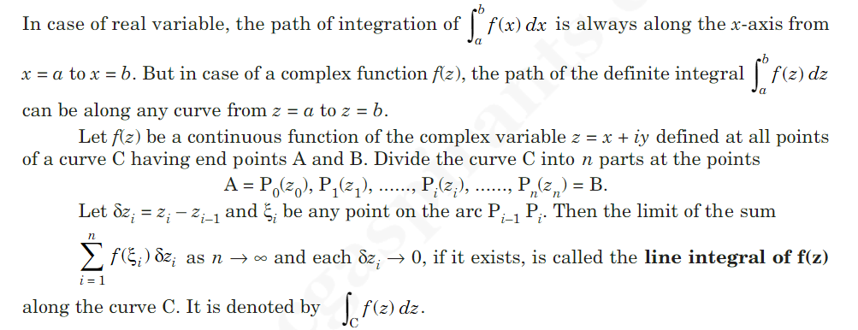
Line Integral in Complex Plane
education for life www.rimt.ac.in
Mechanical Engineering

Slide 4
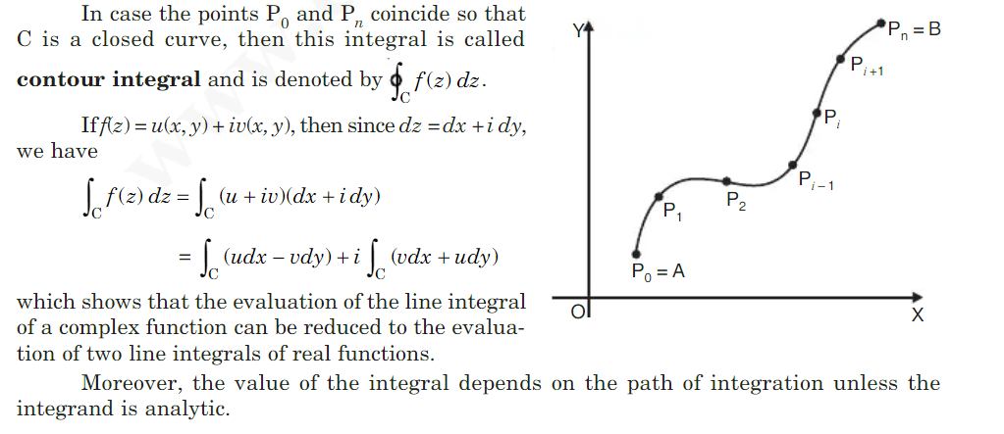
Line Integral in Complex Plane
education for life www.rimt.ac.in
Mechanical Engineering

Slide 5
Line Integral in Complex Plane
education for life www.rimt.ac.in
Mechanical Engineering

Slide 6
Line Integral in Complex Plane
education for life www.rimt.ac.in
Mechanical Engineering

Slide 7
Line Integral in Complex Plane
education for life www.rimt.ac.in
Mechanical Engineering

Slide 8
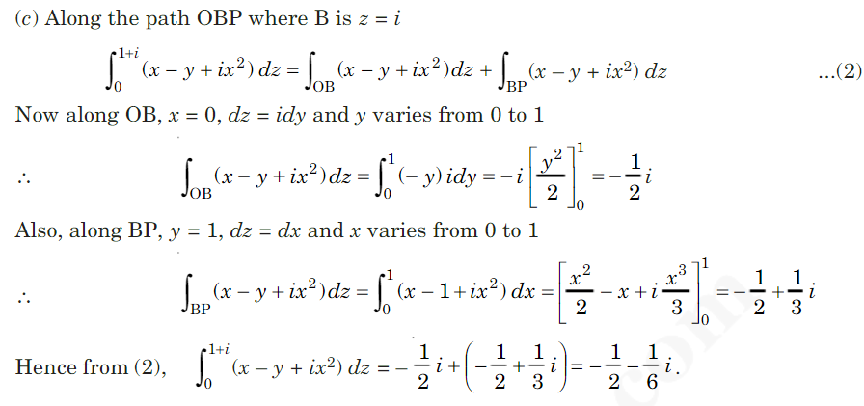
Line Integral in Complex Plane
education for life www.rimt.ac.in
Mechanical Engineering

Slide 9
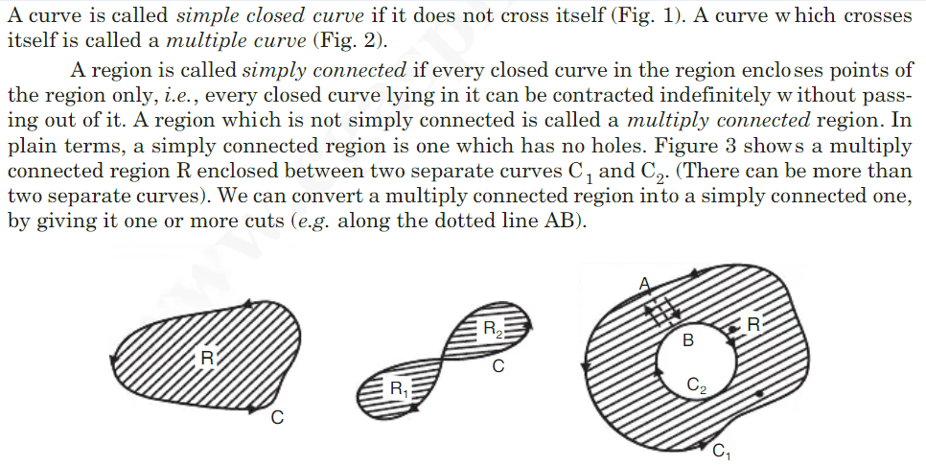
Simply Connected and Multiple Connected Domain
education for life www.rimt.ac.in
Mechanical Engineering

Slide 10
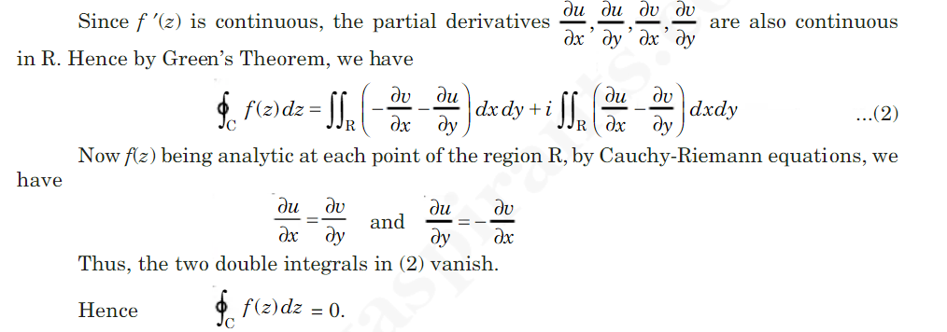
Cauchy’s Theorem
education for life www.rimt.ac.in
Mechanical Engineering

Slide 11
Extension of Cauchy’s Theorem
education for life www.rimt.ac.in
Mechanical Engineering

Slide 12
Cauchy’s Theorem
education for life www.rimt.ac.in
Mechanical Engineering

Slide 13
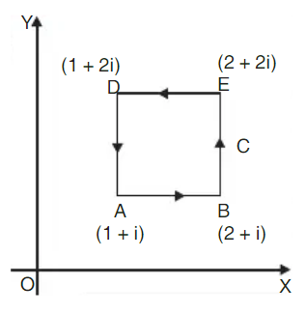
Cauchy’s Theorem
education for life www.rimt.ac.in
Mechanical Engineering

Slide 14
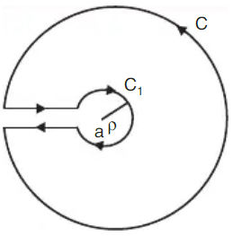
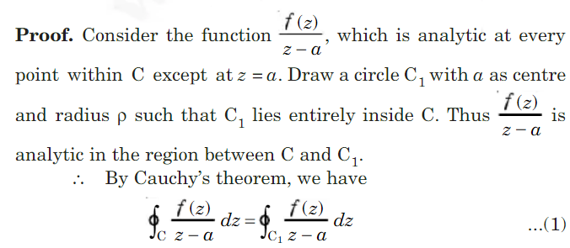
Cauchy’s Integral Formula
education for life www.rimt.ac.in
Mechanical Engineering

Slide 15
Cauchy’s Integral Formula
education for life www.rimt.ac.in
Mechanical Engineering

Slide 16
Cauchy’s Integral Formula for Derivative
education for life www.rimt.ac.in
Mechanical Engineering

Slide 17
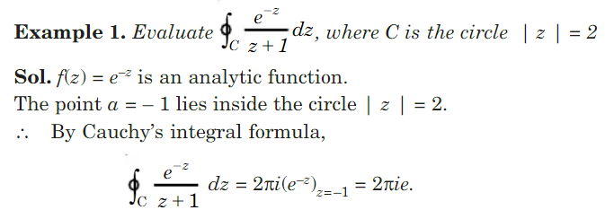
Cauchy’s Integral Formula
education for life www.rimt.ac.in
Mechanical Engineering

Slide 18
Cauchy’s Integral Formula
education for life www.rimt.ac.in
Mechanical Engineering

Slide 19
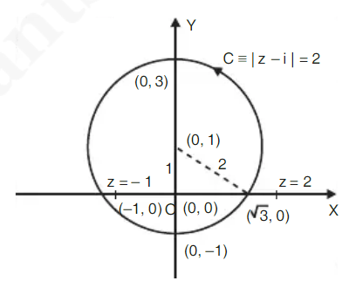
Cauchy’s Integral Formula
education for life www.rimt.ac.in
Mechanical Engineering

Slide 20
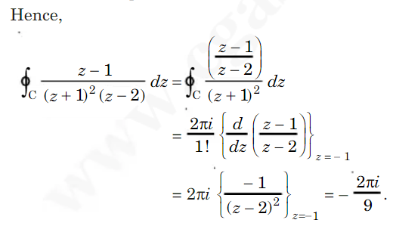
Cauchy’s Integral Formula
education for life www.rimt.ac.in
Mechanical Engineering

Slide 21
Topics Discussed in Next Lecture
Taylor’s and Laurent Series
Singularity
Types of Singularity
Residue
education for life www.rimt.ac.in
Mechanical Engineering

